Slide 1
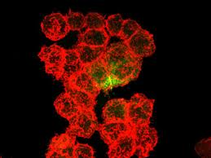
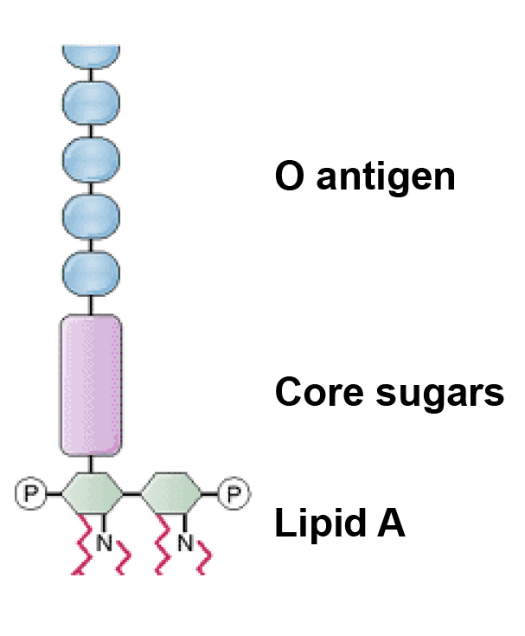
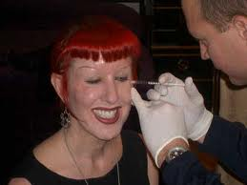
Infectious Diseases
Lesson 4.3

Slide 2
Lesson Objectives:
After finishing today’s lesson, you will be able to:
name adaptations and explain how they benefit bacteria in the right environments.
describe how adaptations are used to gain access to nutrients.
discuss the limits to acquiring adaptations.

Slide 3
Do Now
What do microbes need to become pathogenic?

Slide 4
Do Now
What do microbes need to in order to become pathogenic?
What adaptations might a microbe need to become pathogenic?

Slide 5
Activity: Bacteria Adaption Auction
You have been assigned a body niche/habitat by your teacher and given $1,000.
Your group will design the perfect bacterium for your niche.
Then you will compete with the other groups for adaptations!

Slide 6
Each team has $1,000 to bid with!!!
You have 10 minutes to review the sheet with the adaptations and choose the ones you want.
Questions to consider when deciding:
Which adaptations do you think will be the MOST important for the survival in your environment? Explain why.
The team with the best overall adaptations for their environment will win the game. Which adaptations might you want to keep away from the other teams? Explain why.

Slide 7
While you are deciding on a strategy, look at the characteristics of other bacteria that share your habitat/niche!

Slide 8
Adaption Auction

Slide 9
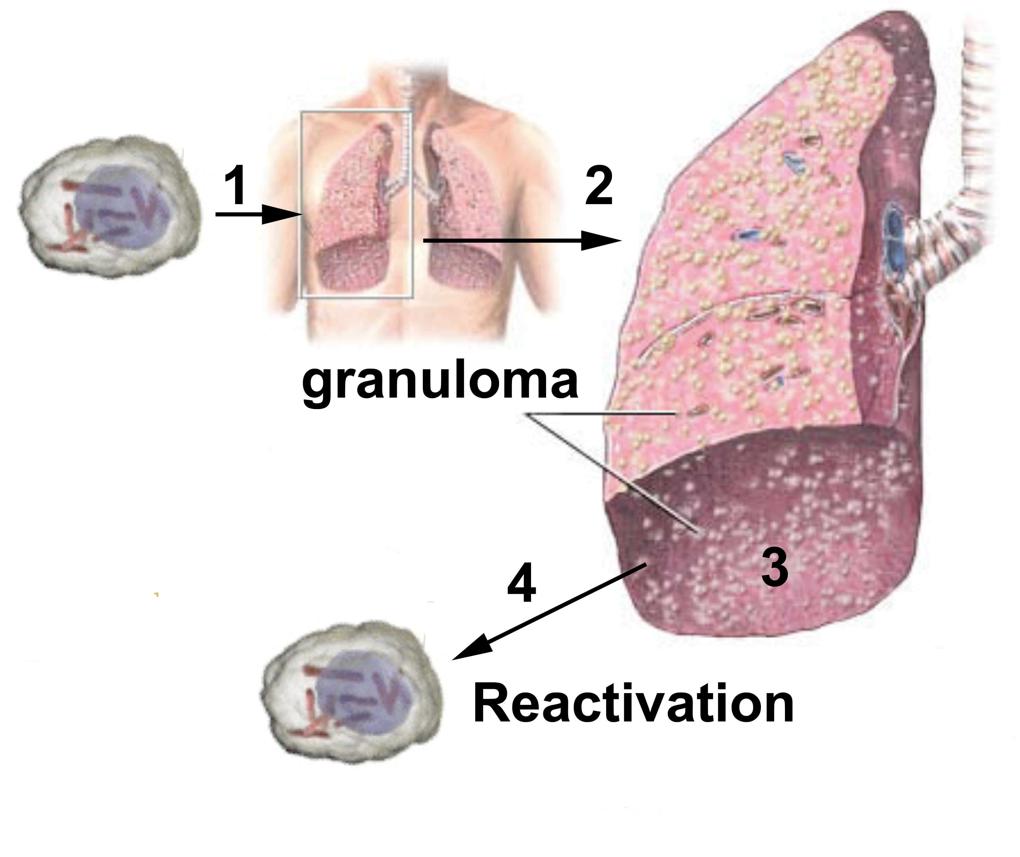
Replicates slowly
Infections can persist for long periods of time.
Example: Mycobacterium tuberculosis replicates intracellularly and slowly.

Slide 10
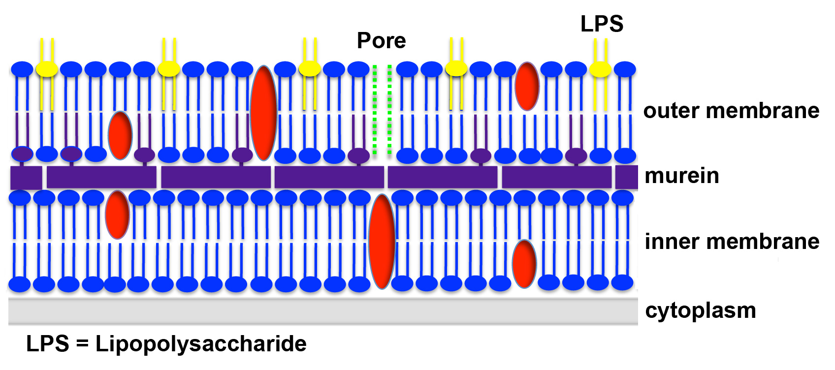
Gram-negative cell wall
Its cell wall contains LPS, an endotoxin that causes inflammation.
Example: Neisseria meningitidis causes meningitis.

Slide 11
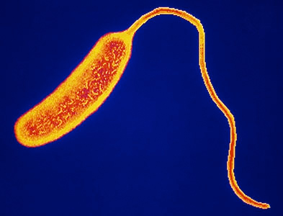
Replicates rapidly
Bacteria that reproduce rapidly spread infections quickly.
Example: Vibrio cholerae

Slide 12
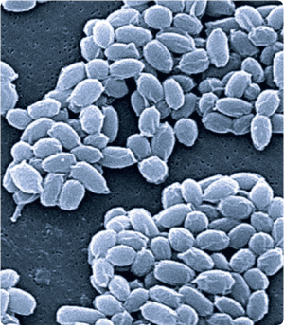
Forms spores
Can form spores to survive when nutrients are depleted. They are durable and act like a time capsule that opens when nutrients are sensed.
Examples: Clostridium tetani,
Clostridium botulinum,
and Bacillus anthracis

Slide 13
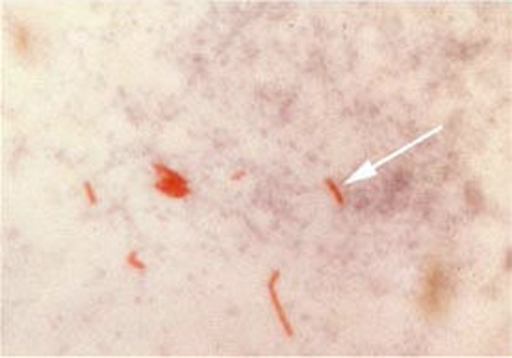
Acid-fast cell wall
Cell wall contains wax that protects it from immune cells and can’t be Gram stained.
Example: Mycobacterium tuberculosis causes tuberculosis.
M. tuberculosis
(an electron microscopy image)
M. tuberculosis (red cells) stained by the acid-fast technique
(a light microscopy image)

Slide 14
Gram-positive cell wall
The thick rigid murein layer. Many Gram-positive bacteria can withstand high salts on the skin.
Example: S. aureus causes MRSA.

Slide 15
Has a flagellum
Has a flagellum that allows it to travel to find nutrition
Example: Vibrio cholerae

Slide 16
Produces exoenzymes

Slide 17
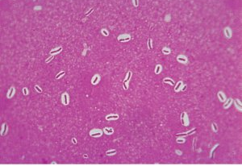
Has a capsule
Capsules are additional layers of sugars outside the cell wall and provide perfect camouflage from the immune system.
Example: Streptococcus pneumoniae
Capsules (white layers) surrounding the cells (pink rods) on pink background.

Slide 18
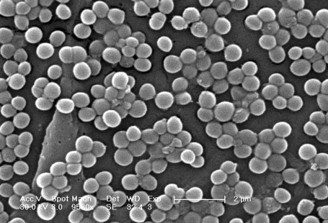
Replicates extracellularly
Allows bacteria to travel to new locations
Example: Staphylococcus aureus can travel in the bloodstream.
http://inst.bact.wisc.edu/inst/index.php?module=Book&func=displayarticle&art_id=137

Slide 19
Produces endotoxins
Endotoxins cause tissue damage and allow spread.
E. coli O157:H7, the ‘hamburger’ bacterium.
http://www.universityofcalifornia.edu/everyday/agriculture/images/e_coli.jpg

Slide 20
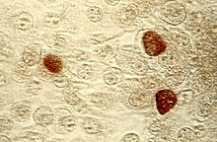
Replicates intracellularly
If the bacterium is inside cells it may be able to persist without causing symptoms.
Example: Chlamydia trachomatis infects genital epithelial cells.
Chlamydia inclusion bodies (brown) in host cells (transparent bubbles).

Slide 21
Exotoxins may have local effects
Vibrio cholerae:
Cholera toxin causes epithelial cells to secrete water into the small intestine.
Shigella dysenteria:
Shigella toxin (Shiga toxin)
kills both epithelial cells and cells lining blood vessels.
Notes:
More than 200,000 cases of dysentery in the US each year, chiefly in children under 5. Shigella is characterized by the small size of the inoculum needed for infection – a few hundred to a few thousand bacteria only. This allows them to be easily transferred from one person to another.

Slide 22
Wrap Up
What limits the number of adaptations a bacteria can have?
Adaptations cost bacteria energy and resources, which slows growth: just like spending money in the auction!

Slide 23
Homework
If you did not finish your worksheet in class complete it as a homework.

